Slide 1
WRNC Training
Basic Wildlife Rehabilitation Course
Hydration

Slide 2
Hydration
Is it always appropriate to administer fluids?
What type of fluids? What temperature should it be?
What is the appropriate route of fluid administration?
What is the appropriate volume of fluids needed?
How rapidly should fluids be given?
How frequently should fluids be administered?
How to monitor the effects and + or - physiological responses?
When should fluid therapy be discontinued?

Slide 3
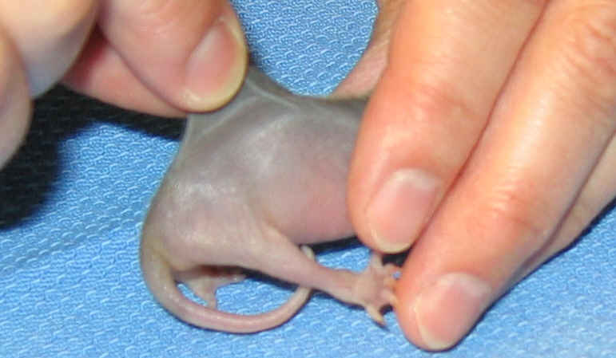
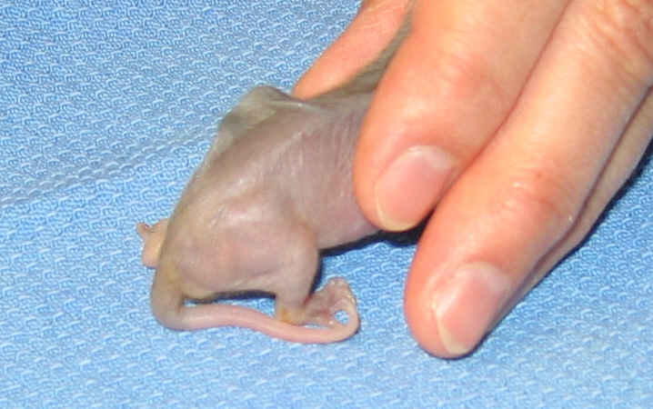
Skin Turgor - Mammals
Well-hydrated: Lifting skin from the dorsal surface of the back & releasing it results in skin snapping back immediately. Check abdomen for “wrinkles”.
Obese animals have fast skin turgor response even if dehydrated.

Slide 4
Skin Turgor - Mammals
% of Dehydration Clinical Signs
< 5 ● Not detectable
5% - 6% ● Subtle loss of skin elasticity
6% - 8% ● Dry oral mucous membranes (mouth,
vulva or rectal mucosa)
● Definite delay in return of skin to normal
● Discolored, dark urine (rabbits can be
brown)
● Slight prolongation of capillary refill time
● Eyes possibly sunken in orbits

Slide 5
Skin Turgor - Mammals
% of Dehydration Clinical Signs
10% - 12% ● Tented skin stands in place-wrinkled
abdomen
● Definite prolongation of capillary refill
time
● Dry oral mucous membranes, no urine
● Possible signs of shock: rapid & weak
pulse, cool extremities
12% - 15% ● Definite signs of shock
● Death imminent

Slide 6
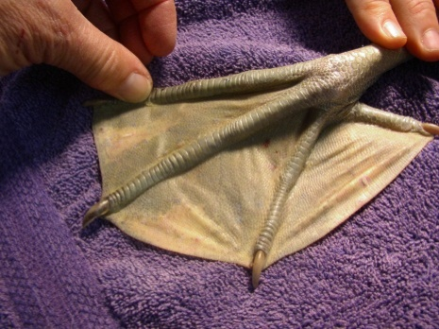
Skin Turgor-Birds/Reptiles
Avian - examine skin turgor on top of feet or legs, upper eyelid, especially abdomen for “wrinkles” & leathery feel in baby birds.
Reptiles - examine on back or abdomen for “wrinkles”,
check eye-lids.

Slide 7
Skin Turgor – Birds/Reptiles
% of Dehydration Clinical Signs
< 5 ● Not detectable
5% - 6% ● Subtle loss of skin elasticity
● Tenting of skin
7% - 10% ● Loss of brightness around eyes
● Slow upper eye-lid turgor
● Dry, ropy mucous membranes
● Thick, pasty urates

Slide 8
Skin Turgor – Birds/Reptiles
% of Dehydration Clinical Signs
10% - 12% ● Tented skin stands in place
● Muddy color to scales of feet, cool
extremities
● Dry mucous membranes
● Rapid heart rate
● Depressed
●No urates at all
12% - 15% ●Definite signs of shock, extreme depression
● Near death

Slide 9
Fluid Therapy- How does it work?
The cell membrane regulates the water molecules
and concentration of solutes (salts, electrolytes) moving
into and out of each cell. This is called Osmosis.
Tonicity – tension of fluids within & outside cell membranes.
Isotonic – will not draw fluid out of cells by osmosis.
Hypertonic – can draw fluids out of the cells resulting in increased levels of dehydration.
Hypotonic – can force fluid into cells, maybe too much (edema).

Slide 10
Isotonic
Equal parts salt and water
Hypertonic
More salt, less water
Hypotonic
More water, less salt
Notes:
Graph created by Carol Simpson.

Slide 11
Isotonic
Introduced fluids
Same outside cell
Same inside cell
No water movement
Hypertonic
Less water outside cell
More salt outside cell
Water inside leaves cell to dilute salt outside
Hypotonic
More water outside cell
Less salt outside cell
Water enters cell to dilute salt inside
Notes:
Diagrams created by Carol Simpson.

Slide 12
Fluid Therapy- Purpose
Two categories of fluid therapy:
Replacement and Maintenance
*Replace current fluid deficits (dehydration)
*Replace ongoing losses (vomiting, diarrhea, bleeding)
*Supply daily fluid needs (maintenance)
Most importantly,
Aids in recovery from shock

Slide 13
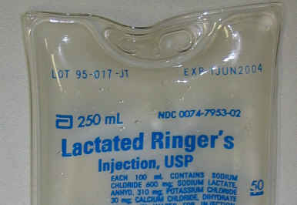
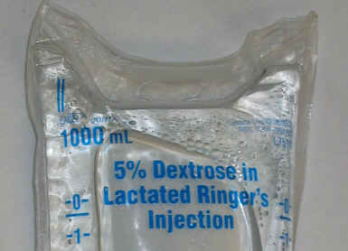
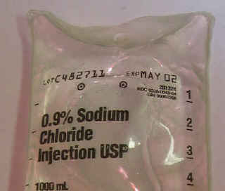
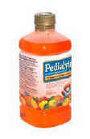
Fluid Therapy- Types of Solutions
Summary of Fluids
Product Tonicity Calories Route(s)
Lactated Ringers Isotonic 9/L Oral, SQ, IV, IP
Dextrose 5% (D5W) Isotonic 170/L Oral, IV, IP
Normal Saline (0.9%) Isotonic 0/L Oral, SQ, IV, IP
Normosol-R Isotonic 18/L Oral, SQ, IV, IP
Pedialyte Isotonic 100/L Oral only
Lactated Ringers & 5% Dextrose Hypertonic 179/L Oral, IV - only

Slide 14
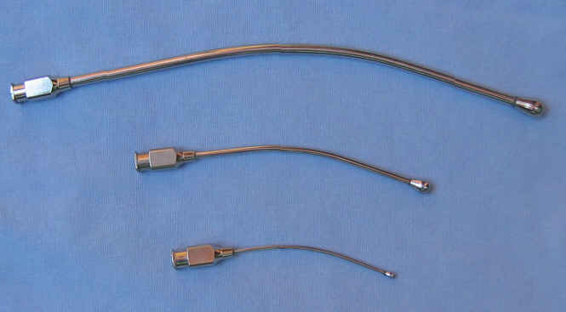
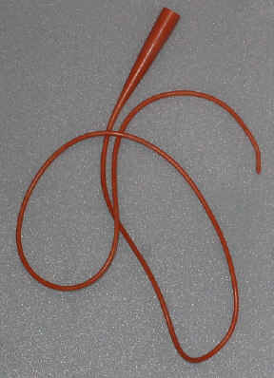
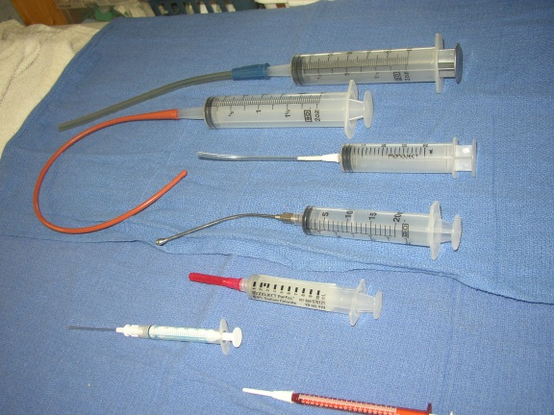
Fluid Therapy- Route of Administration
Oral - Fluids through the mouth (PO). Use with alert patients with no clinical signs of gastrointestinal stasis, vomiting or diarrhea, or not severely dehydrated.

Slide 15
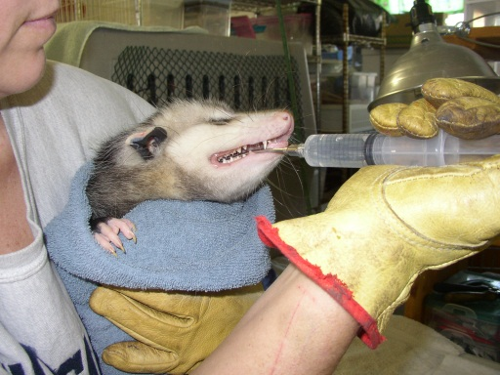
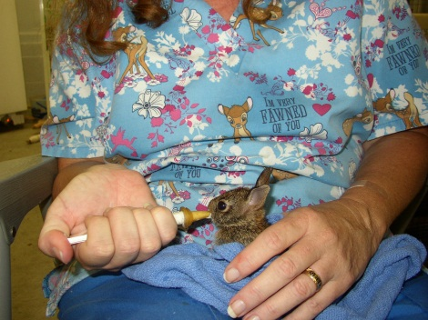
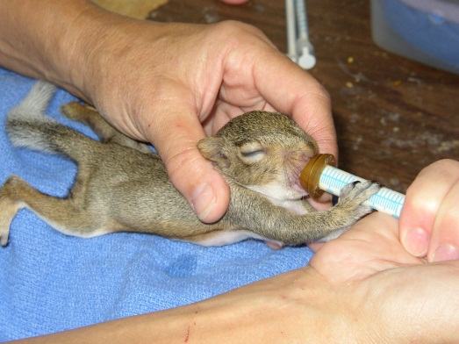
Oral Fluid Therapy in mammals
Encouraging them to drink on their own is a goal for older mammals. Good tasting fluids are easier to get babies to accept and not spit out or fight drinking.

Slide 16
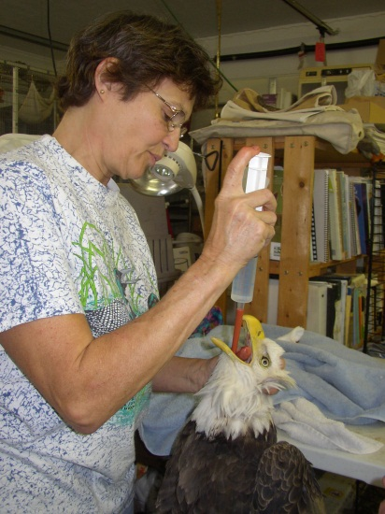
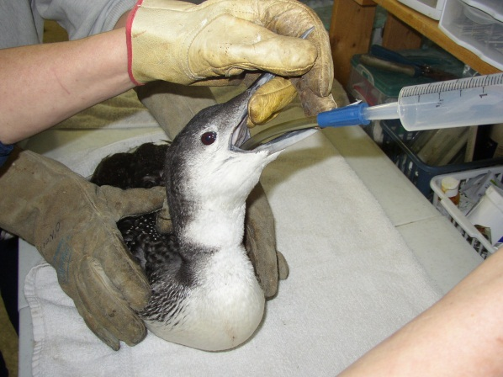
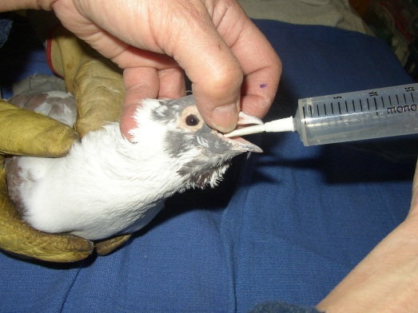
Oral Fluid Therapy in Birds
Appropriate size tubing is required to match
the size of bird and size of throat.

Slide 17
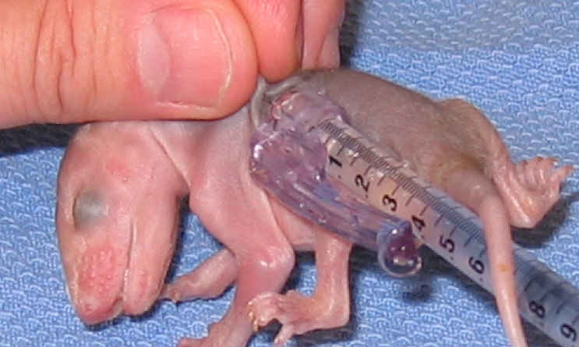
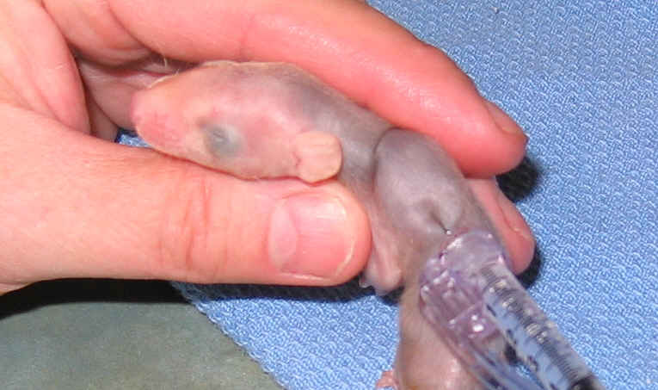
Subcutaneous (SQ) - mammals
Subcutaneous (SQ) - Fluids are delivered under the skin. Can be delivered intra-scapular, at the flank or abdominal flank. Do not give to hypothermic animals. Fluids must be warm, but not too hot.
Notes:
Scapula is shoulder blade, so aim between them and avoid the spine.
The bolus or “bleb” is the bubble of fluids that occurs. It will gradually disappear.

Slide 18
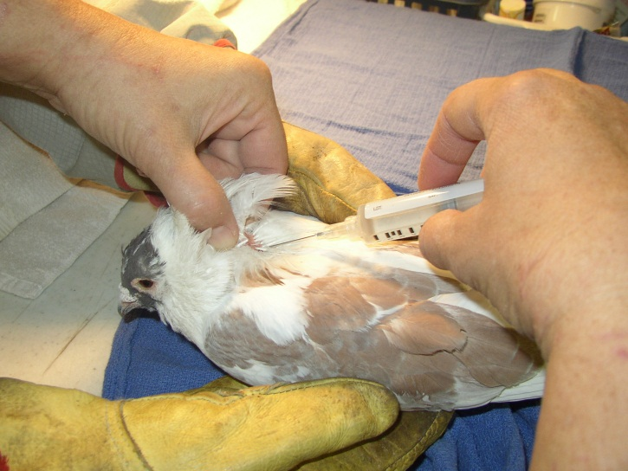
Subcutaneous (SQ) - birds
Subcutaneous (SQ) - Fluids are delivered intra-scapular, same as for mammals. There is a bare spot without feathers on either side of the spine.
Notes:
Scapula is shoulder blade.
No bare spots on water birds or waterfowl.

Slide 19
Fluid Therapy- Route of Administration
Intravenous (IV)-Into the vein-Beyond the scope of this lesson.*
Intraosseous (IO)-Into the bone-Beyond the scope of this lesson.*
Intraperitoneal (IP)-Into the abdomen-used on reptiles. Beyond the scope of this lesson.*
*Discuss with your veterinarian. Receive hands-on inservice.

Slide 20
Fluid Therapy- Route of Administration
Route Advantages Disadvantages/Limitations
Oral ●Rapid administration ●May be contraindicated because of
●Minimal side effects gastrointestinal disease.
●Economical ●Slower than some other routes
●Caloric needs may be met ●Selective administration of fluid
may be more difficult
SQ ●Convenient ●Limited to isotonic solutions
●Rapid ●Absorption may not be efficient
●Solutions higher in potassium ●Solutions irritating to tissues
content may be given cannot be given
●Best for species with loosely ●Not suitable for large animals
attached skin
●Can be used with most species

Slide 21
Fluid Therapy- Route of Administration
Route Advantages Disadvantages/Limitations
IV ●Rapid dispersion within body ●Greater chance of side effects
●Precise dosage possible ●Limited number of sites available
IP ●Rapid absorption ●Potential for injury to organs
●Used for reptiles & rodents ●Limited to isotonic solutions
IO ●Rapid absorption ●High risk of infection
●Uncomfortable procedure
All of these are beyond scope of this class. Discuss with your veterinarian.
Receive hands-on inservice.

Slide 22
Fluid Therapy- Rate of Delivery
Fluid deficits are estimated based on hydration determined from physical exam findings.
Percent of dehydration is multiplied by the animal’s weight in Kg. and this equals the volume of replacement fluid in ml’s or cc’s.
Maintenance fluids are the volume of fluids which are required during a 24 hour period by a healthy animal.
Species Maintenance Fluids
Avian 50-60 ml/kg/day
Canids 45ml/kg/day
Felids 50ml/kg/day
Rabbit 50-100 ml/kg/day
Rodent 50-100 ml/kg/day
Reptile 10-15 ml/kg/day
In shock 90 ml/kg/day

Slide 23
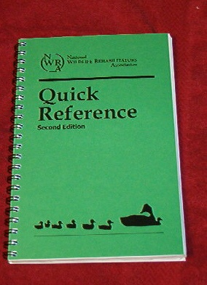
Fluid Therapy- Rate of Delivery
Use NWRA/IWRC Fluid Charts

Slide 24
Assume 10% dehydrated to start and
replace over 24 hours (or 5% in 12 hours)
Assume rate of 50 ml/kg or 50 ml/1000 gms which is 5/100 or 5% for maintenance
Add 5% and 5% and get 10% - for 12 hours
SO
Take 10% of weight in grams and divide by 3
Administer this amount TID – SIMPLE!

Slide 25
“Down and Dirty”
Practice: You get in an opossum that weighs 302 grams and is slightly lethargic.
302 divided by 10 is 30.2
30.2 divided by 3 is 10
So give 10 cc of LRS

Slide 26
Monitoring Response to Fluid Administration
Complete Physical Exam to determine extent of hydration status.
Monitor bladder – check for abdominal swelling, pear shape, or visible bladder.
For partial hind-end paralysis, may have to evacuate manually.
Monitor urine color and frequency – check bedding for color and dampness.
Check mutes (in birds) for consistency of urates.
Check mucous membranes in mouth, an skin color, and refill time.
Skin turgor and abdomen “wrinkling” should improve.

Slide 27
The goal is to be able to slowly wean off the replacement fluid therapy once you have “refilled” the deficit level you started with.
The patient is rehydrated when it is capable of ingesting maintenance volume of fluids on its own, usually through eating and drinking.

Slide 28
Monitoring Response to Fluid Administration
Patient attitude & activity level should increase.
Improved heart rate, pulse rate, and pulse quality.
Do not discontinue fluid therapy abruptly-reduce by 25%-50% per day slowly.
Take into account normal food intake increasing when decreasing fluids.
It is possible to overhydrate with resulting accumulation of fluids in the lungs or development of respiratory disease.

Slide 29
Fluid Therapy-Summary
● Fluid therapy is vitally important! May mean life or death.
● Fluid therapy is challenging & rewarding.
● Learn the basics, understand the theories & KEEP IT SIMPLE.
● Good technique is acquired with practice.
● Some techniques can be practiced on carcasses.
● Work with an experienced co-worker to practice on live animals,
and to ask for help.
● Take advantage of lab time with experienced professionals.

Slide 30
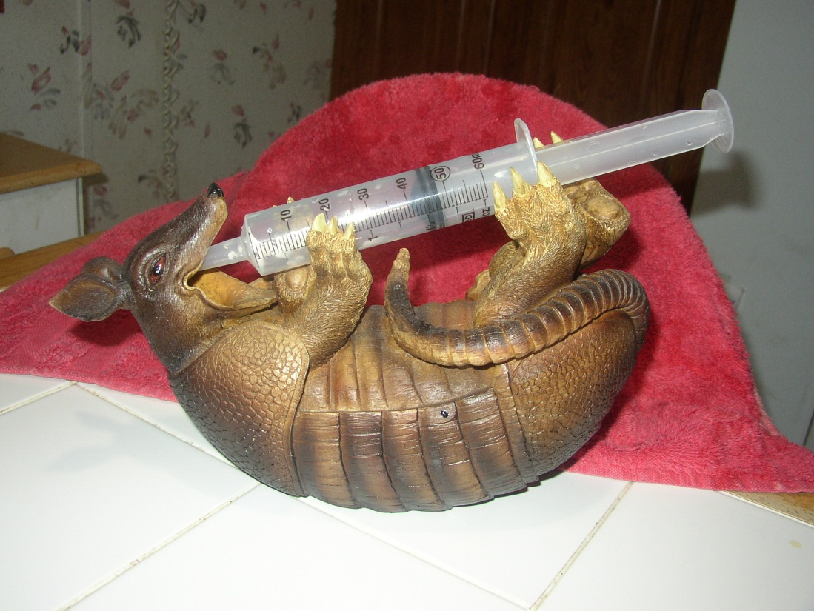
If you can get them to cooperate,
that’s the easiest way of all!

