Slide 1
Feather Imping
By Betty O’Leary

Slide 2
What is Imping?
Imping is the process of replacing broken feathers on one bird with new ones from another bird. This is done by using an internal splint inside of the hollow shaft of the feather.

Slide 3
Why Imp?
Broken feathers can hinder or even prevent a bird from being able to fly well enough to survive in the wild. Therefore it is important that birds have good feather condition before being released back into the wild.
Depending on the time of year, and species, it can take from one month to two years for a bird to molt out the broken feathers and replace them with new ones.
Imping allows you to release the bird now instead of holding the bird for the amount of time it takes for it to molt in new feathers.

Slide 4
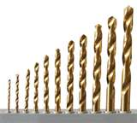
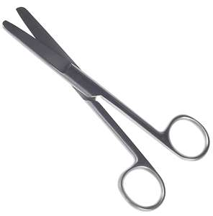
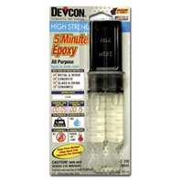
Tools needed for Imping
Scissors
Drill bits
5 minute epoxy
Pieces of paper to put between feathers
Bamboo skewers or feather shafts
Feathers to be used for imping. It must be the exact same feather that is broken on the bird that is being imped. (Example: Right primary #8 must be imped with a right primary #8) and from the same species and approximately the same sized bird.

Slide 5
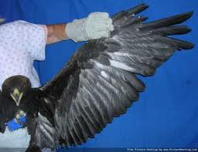
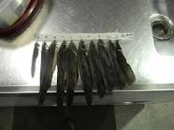
How to Imp
Examine the bird ahead of time to see
which feathers need imping. This
prevents the bird from being stressed
by being held longer than needed
while the feathers are being prepared for imping.
Remove feathers needed from a cadaver or saved wings by cutting them around one half inch from the follicle.
The feather can be cut shorter later if needed. Make
sure that you keep track of which feather
is which. You can do this by numbering
them. (Example: R9, R4, L8)

Slide 6
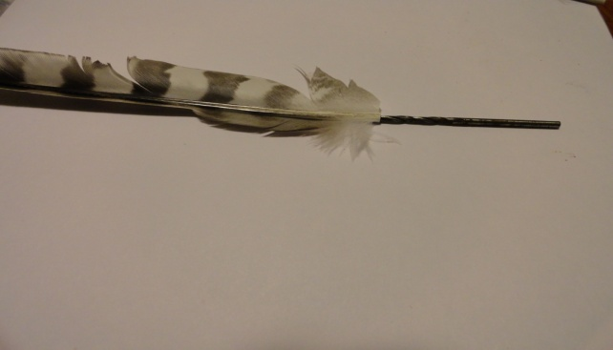
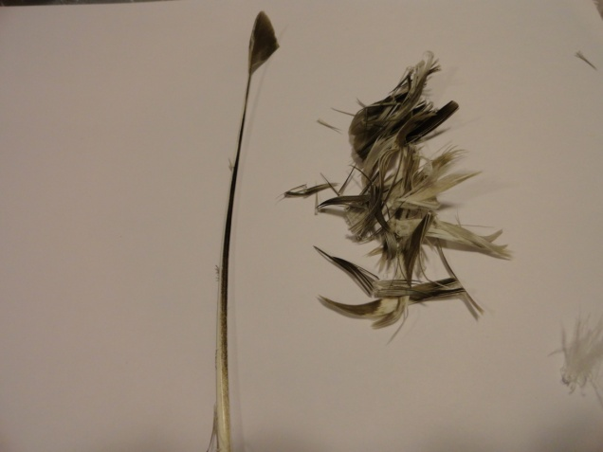
How to imp continued…
If using loose molted feathers or from a cadaver, rip off the barbs from the shaft. They do not have to be from the same species that is being imped, although same species works best, but they should be the same type of feather (Ex: outer primary, inner primary, secondary) and from a similar species of bird.
Use a drill bit to ream out the
inside of the feather shaft on the
feather that is being imped.

Slide 7
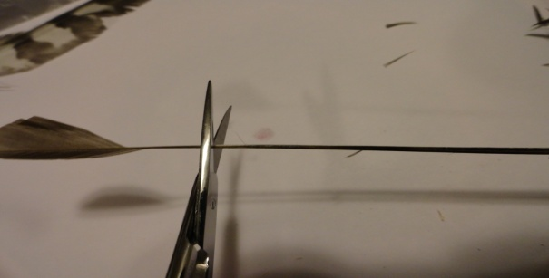
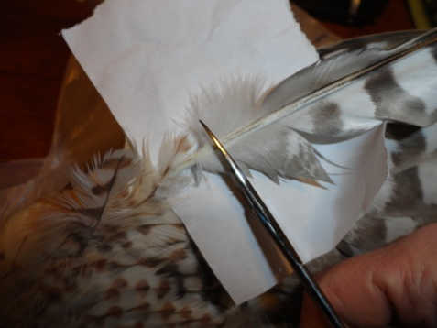
How to imp continued…
Cut the top off of the debarbed shaft until it fits snug into the hollow shaft of the feather being imped. If using bamboo skewers widdle down if needed to make a snug fit.
Once all of the feathers are prepared, get the bird that is being imped.
Slide a piece of paper under the feather being imped.
Cut the broken feather on the bird at the appropriate location, so the feather is the
correct length once imped.

Slide 8
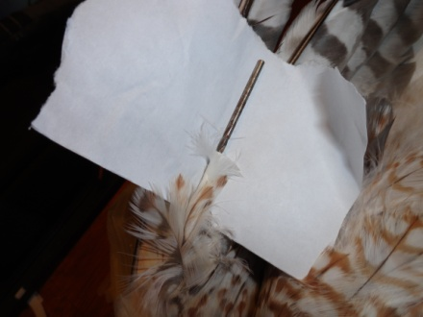
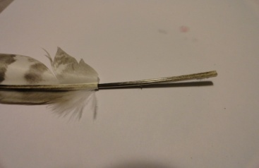
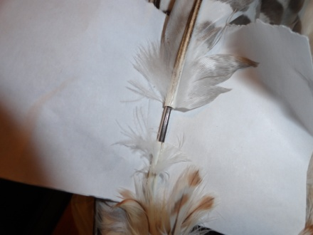
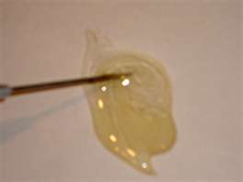
How to imp continued…
Ream out the shaft on the bird
with the drill bit.
Cut the bottom end of the debarbed shaft, or the bamboo skewer, that is being used as the splint to the correct length so it fits sung inside of the shaft on the bird.
Once splint is cut to fit correctly, remove it from both shafts and apply glue to the top half and place into feather shaft. Then apply glue to the bottom half and place into shaft in the bird.

Slide 9
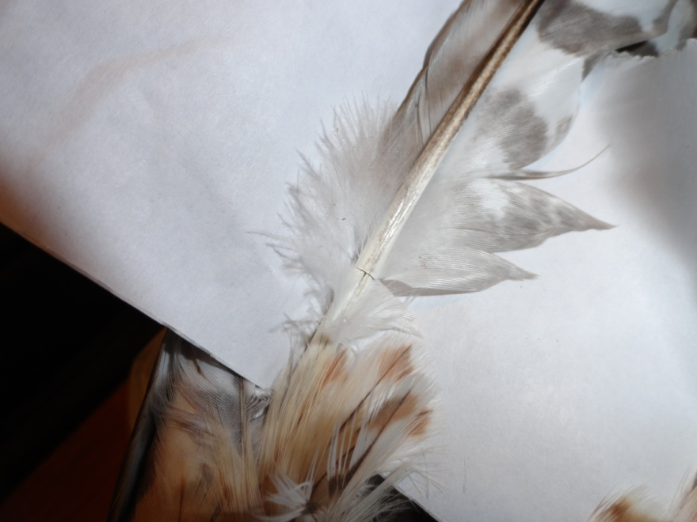
How to imp continued…
Make sure that the feather is pushed in all the way and the two ends meet flush. It is also very important to make sure that the feather is rotated the correct direction.
Once glue is dry, remove
the paper and arrange
the feathers back into
place.

Slide 10
Your Turn!

